Slide 1
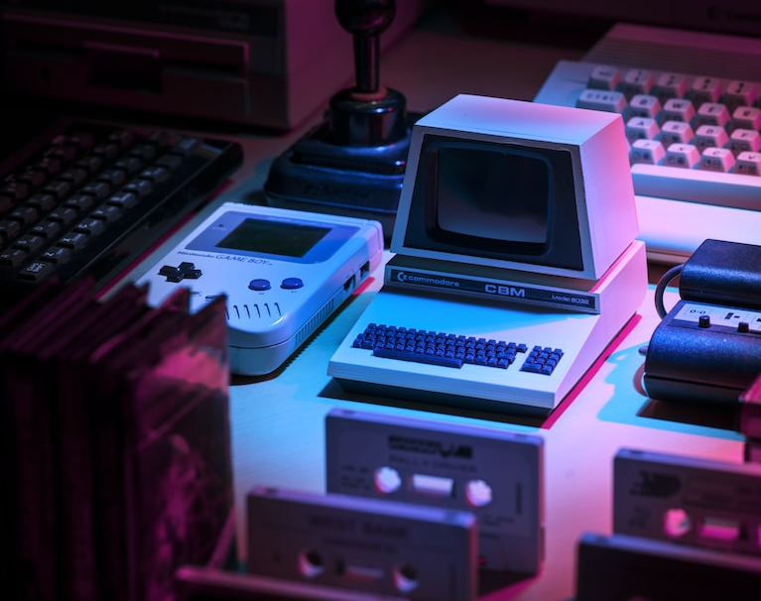
DevSpace : A Full Stack Social Media app for Developers
- Vimal Kunwar

Slide 2
CONTENTS
INTRODUCTION
TECHNOLOGY STACK
FRONTEND DEVELOPMENT
Modules Used
Login Page
Login widget
Register widget
Home Page
User widget
Post widget
Create-post widget
Community widget
Connections widget
Profile Page
Future updates
BACKEND DEVELOPMENT
Modules Used
Schema Diagram
User
Post
Friend
Images
Server Routes
Auth
User
Post
Future updates

Slide 3
Introduction
Devspace is a social media platform for developers to join communities and grow together. The platform provides features such as user registration and login, profile creation, community creation, discussion forum and learning resources.
Devspace is built using the MERN stack (MongoDB, Express, React, Node.js) and provides a user-friendly interface and intuitive design.
The platform aims to make it easier for developers to network with other professionals, collaborate on projects, find new opportunities, and share knowledge. By creating a space for developers to connect, learn, and grow, Devspace is a valuable resource for developers of all levels.

Slide 4




Technology Stack
The technology stack used for the development of the Devspace app is the MERN stack, which stands for MongoDB, Express, React, and Node.js.
MongoDB: used as the database management system for the app. It is a NoSQL document-oriented database that stores data in JSON-like documents.
Express: a web application framework for Node.js. It is used to create the backend of the app and handle HTTP requests from the client-side.
React: a JavaScript library for building user interfaces. It is used to create the frontend of the app and provide a rich user experience.
Node.js: a JavaScript runtime environment that allows developers to run JavaScript on the server-side.

Slide 5
FRONT-END DEVELOPMENT

Slide 6
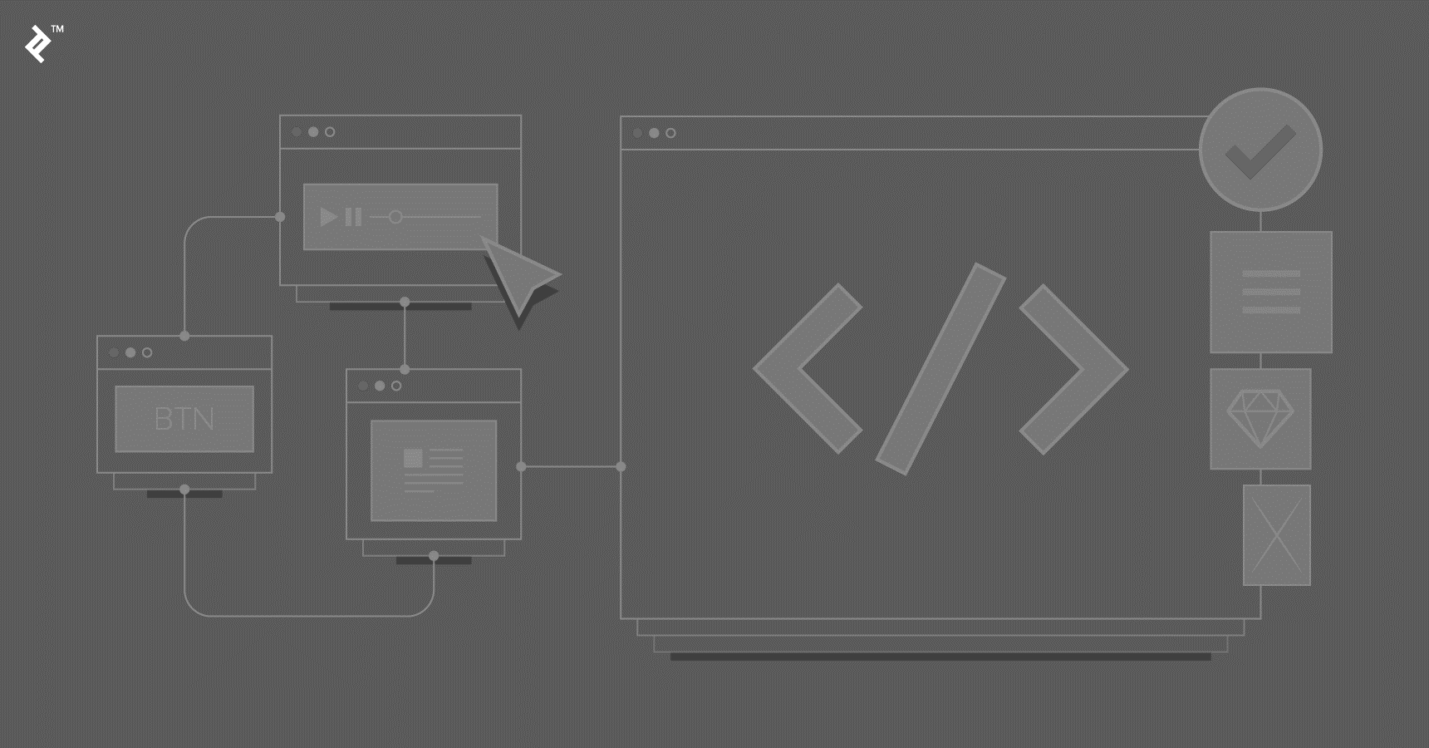
Front-End
Modules used in frontend design and development –
react-router-dom: React Router is used to handle routing in the app and provides a way to navigate between different pages and components.
formik + yup: Formik is a library for building forms in React. It is used in combination with Yup, a validation library, to provide robust form validation and error handling.
@reduxjs/toolkit: Redux Toolkit is used to manage the state of the app and provides a predictable way to update and manage the data in the app.
redux-persist: Redux Persist is a library for persisting the Redux store to local storage. It is used to save the state of the app between sessions, providing a seamless user experience.
react-dropzone: React Dropzone is a library for handling file uploads in React. It is used to enable users to upload images to the app, which are then stored and displayed in the user's profile or community pages.
@mui/material: Material UI is a React UI framework that provides pre-built, customizable components for building modern web applications. It is used to create the visual design of the app, including buttons, forms, icons, and other UI elements.

Slide 7
Login Page

Slide 8
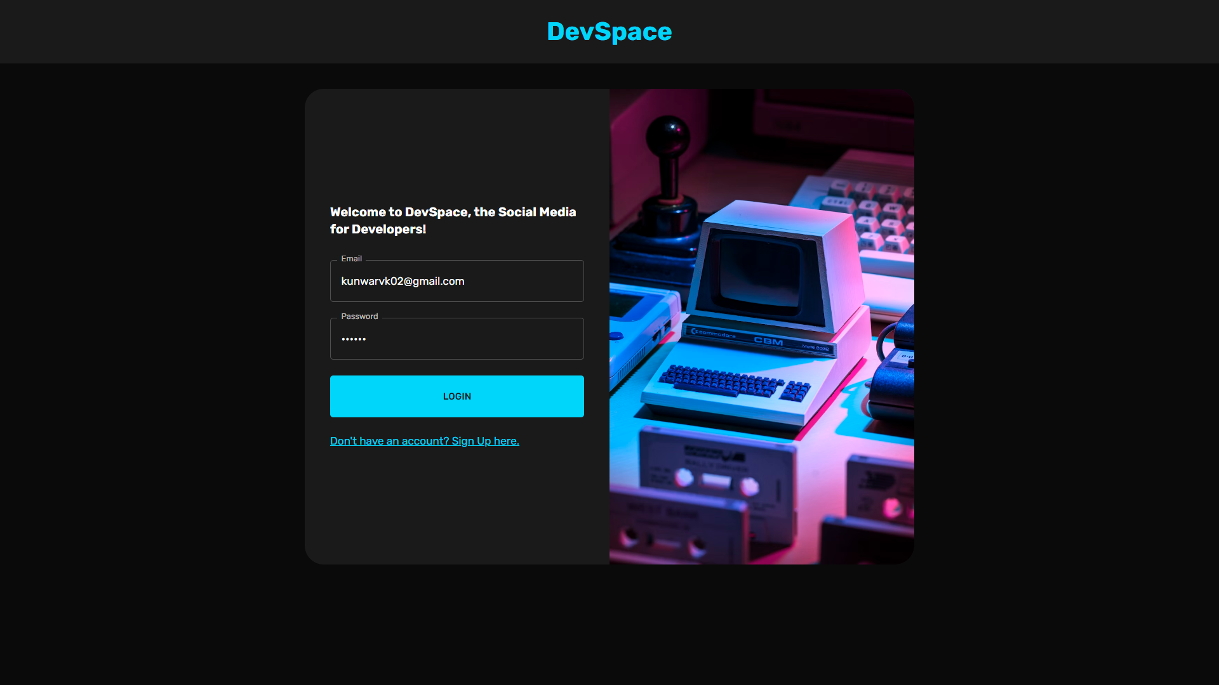
Form made using Formik and validation and error handling done through Yup module.

Slide 9
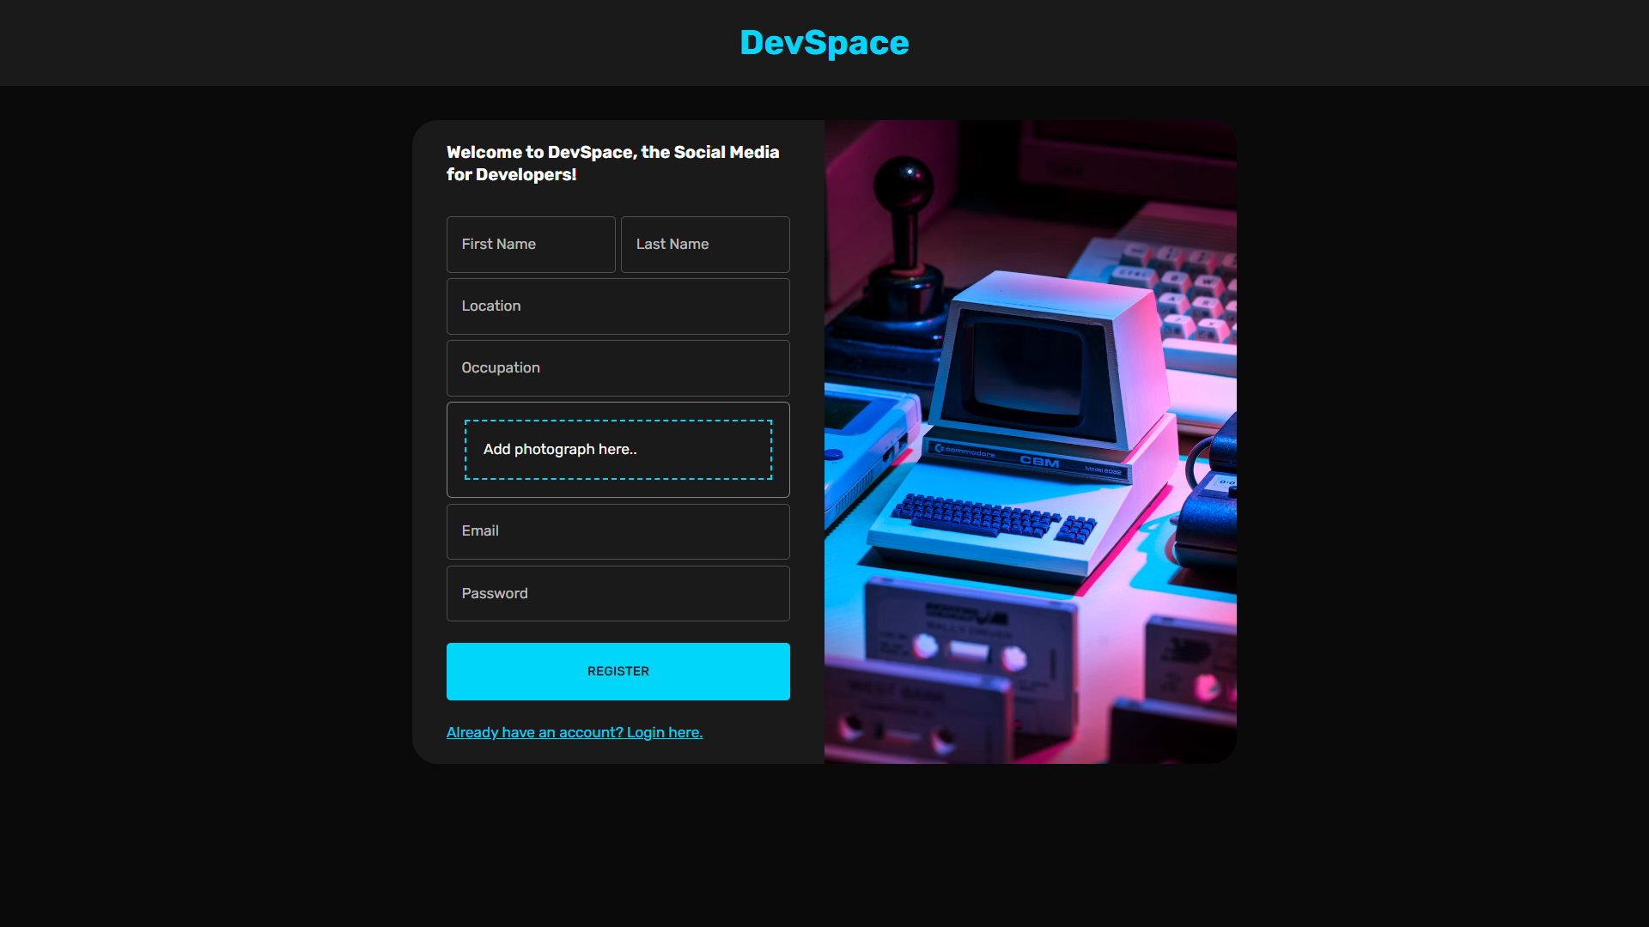

Slide 10
Login Page

Slide 11
Home Page

Slide 12
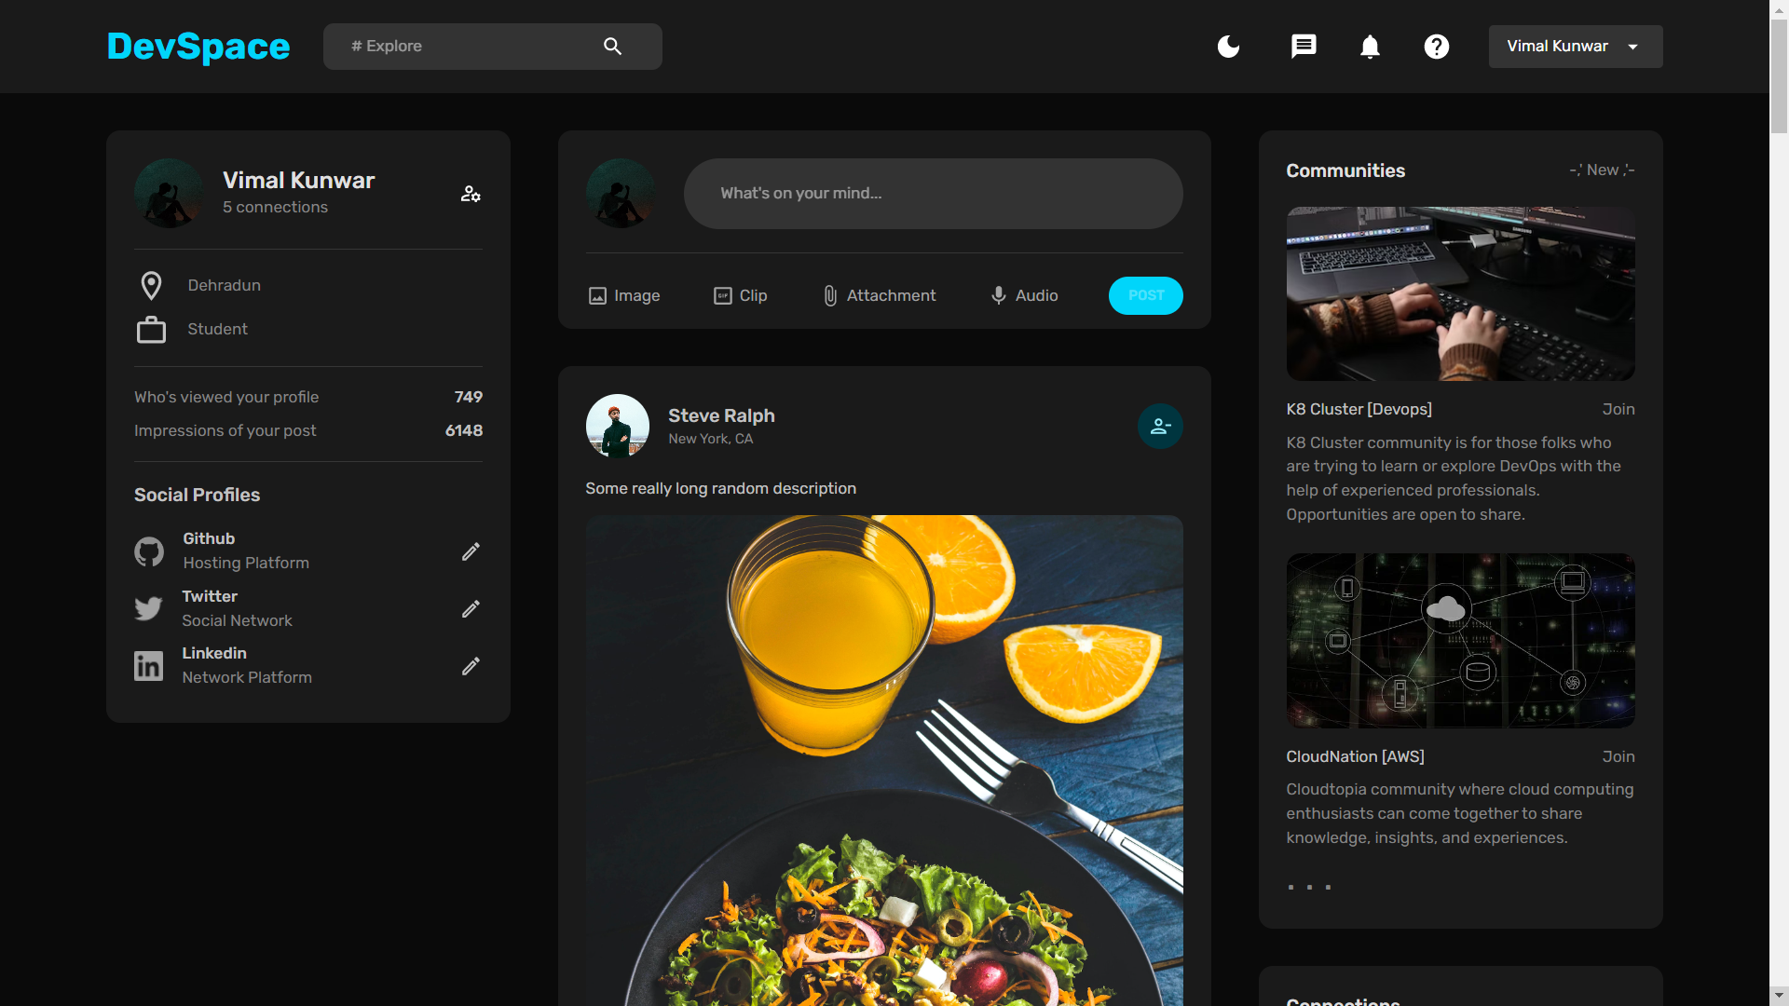

Slide 13
NAVBAR COMPONENT
App Logo – Devspace app logo is shown at the left side of the navbar.
Search Bar – A search functionality is added which can be used to search people, communities and companies on the app.
Icons –
Mode Icon – with this the user can switch between light or dark mode.
Notification Icon – can be used to check new notifications.
Message Icon – can be used to open up conversation menu.
About us icon – can be used to know more about DevSpace.
User Profile – expands to show the current user and the option to log out.

Slide 15
USER WIDGET
Username Section – This includes the profile photo, username and the number of connections the user has.
User Info – This section shows the current location and job of the user.
Profile Info – This section shows the number of views on the user's profile and how many times impressions the users post has got.
Social Profile – This section allows the user to link other social profiles handles to his/her account. Eg- GitHub, Twitter and LinkedIn.

Slide 17
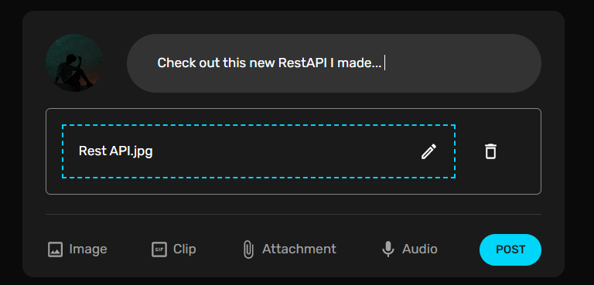
CREATE POST WIDGET
User profile photo – the user’s profile photo is shown at the start.
Text Box – where the user can input news or any updates.
Dropbox – where the user can drop any image, clip, attachment or audio.
Options – to choose which type of file needs to be uploaded.
Post button – to upload the post to the database and link it to the user’s profile.

Slide 19
COMMUNITIES WIDGET
Each component inside the widget have the following sub-parts :
Community Banner Image – this shows the specific community’s banner image.
Community Name – this shows the name of the community with the corresponding domain name in square brackets ‘[ ]’.
Join Button – the button can be used to join the community and be a part of it.
Community Description – this section involves the description of the community.
View more button – expands the widget to show all new and popular communities in DevSpace.

Slide 20
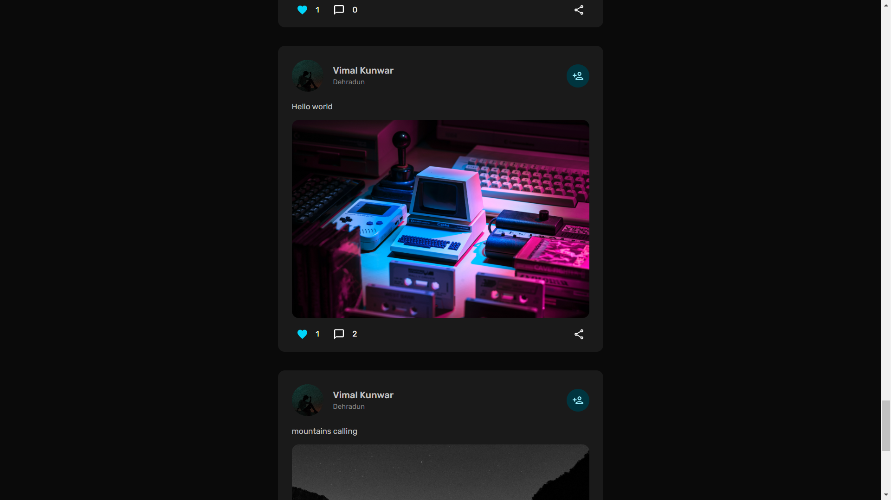
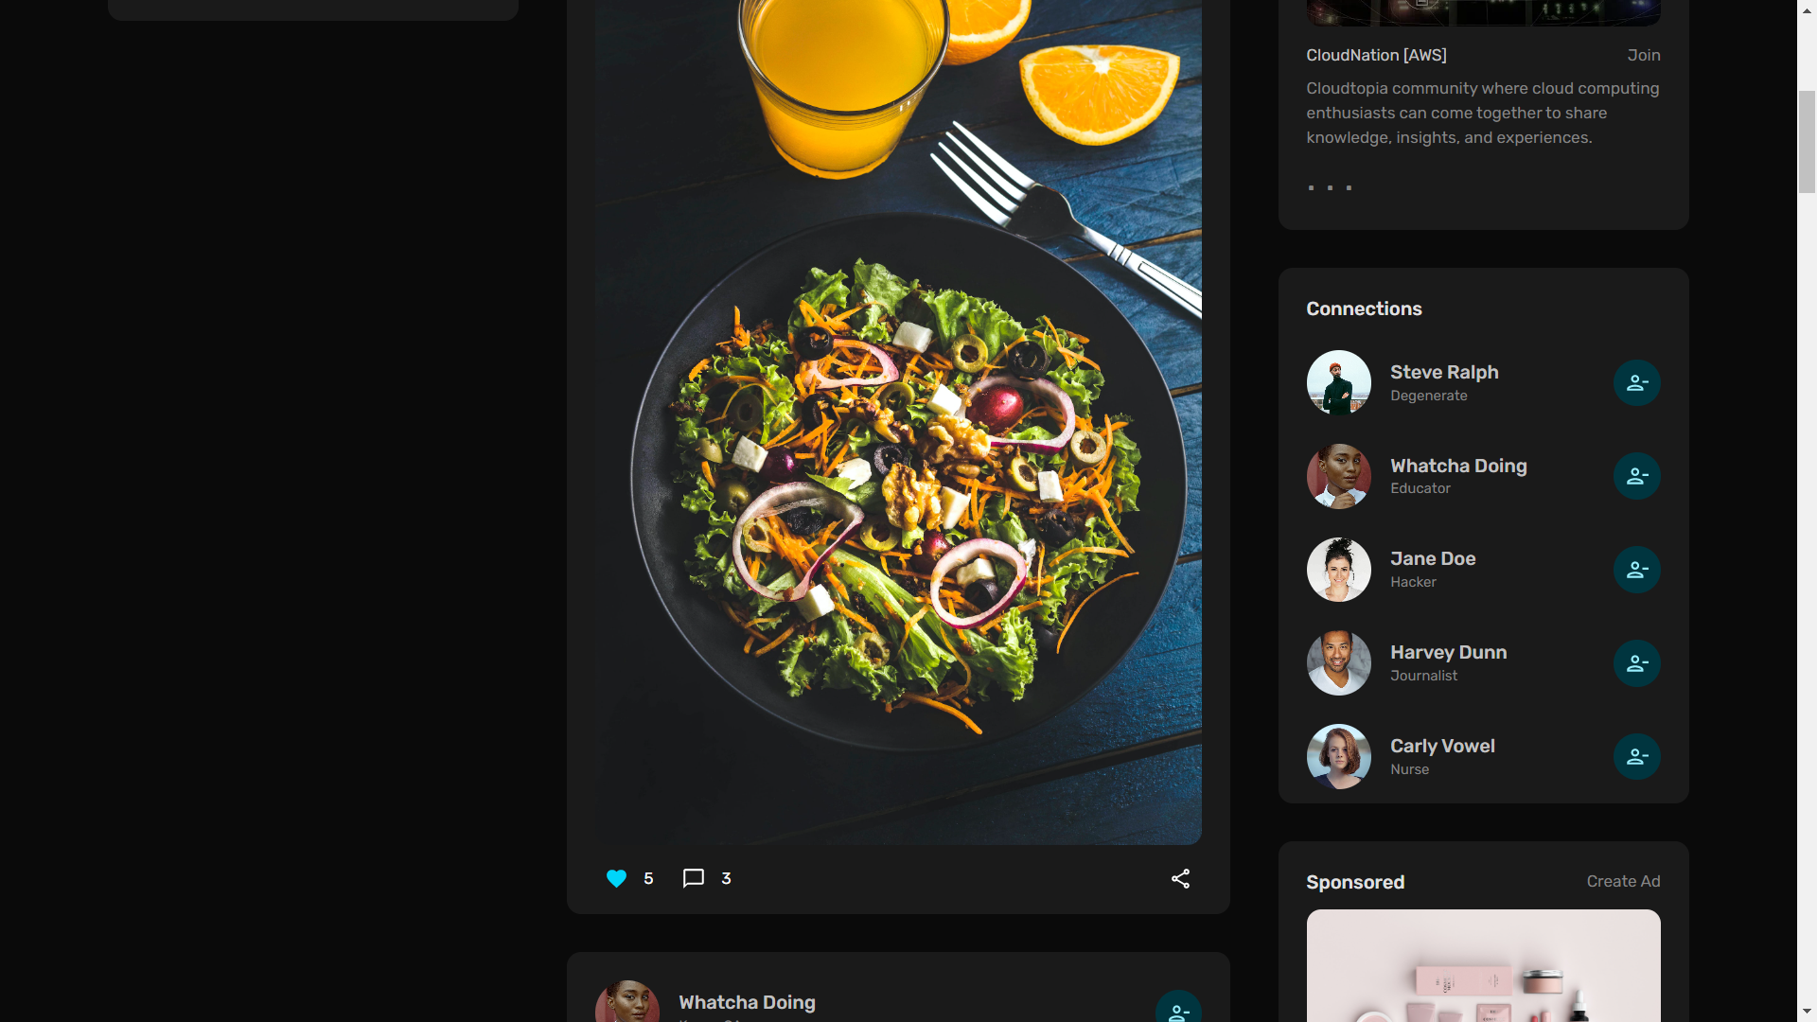

Slide 21
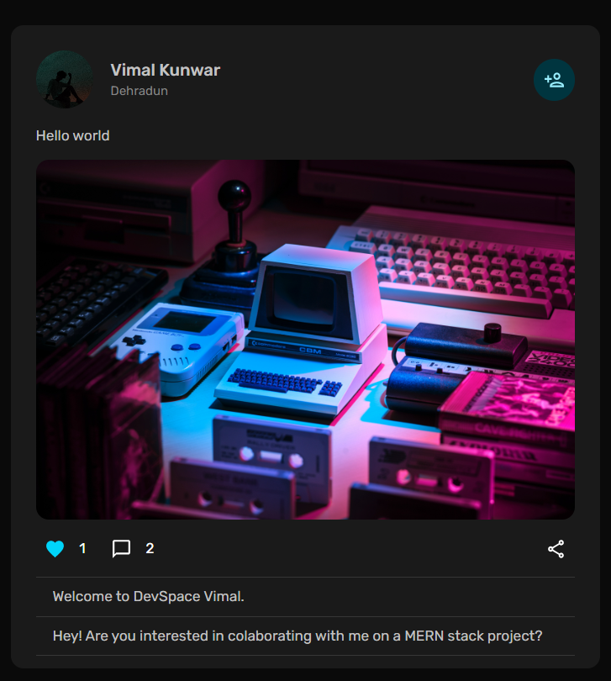
POSTS WIDGET
Each post widget has the following sub-parts :
Details – profile photo and name of the user the post belongs to. Clicking on the name redirects to the user’s profile page.
Add/ Remove connection button – the button can be used add or remove the user from our connection list.
Post Description – the text part added by the user.
Post Image – this holds the post image/clip/audio uploaded by the user.
Like button – can be used to like/unlike the post.
Comments button – expands the comment section of the post.

Slide 23
CONNECTION LIST WIDGET
Each list item has the following sub-parts :
User Details – profile photo and name of the user. Clicking on the name redirects to the user’s profile page.
Designation – the designation/job of the person.
Add/ Remove connection button – the button can be used add or remove the user from our connection list.

Slide 25
Home Page

Slide 26
Profile Page

Slide 27
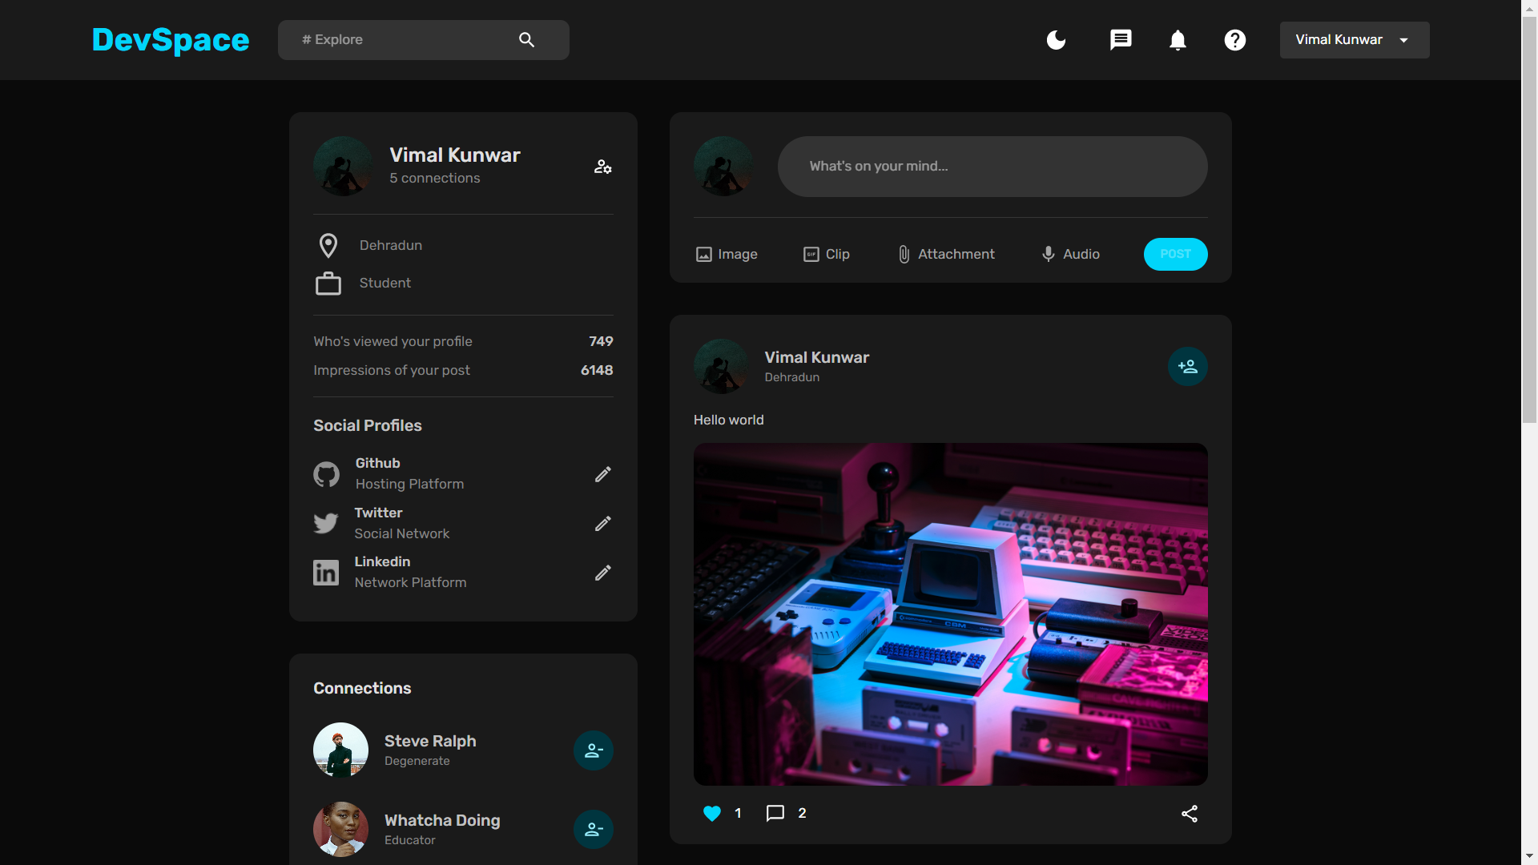
User Widget
Create
Post Widget
Posts Widget
Connections Widget

Slide 28
Profile Page

Slide 29
Future Changes
Few new features need to be added to the webapp, namely :
Conversation page/menu: where all the community chats and private chats can be shown.
Jobs Listing: A section which will be added to the sidebar where one can scroll and add job listings on the webapp.
Community Page: The community page where people can post, open threads and reply to them.
Company/Organization Page: Where all the information about a company can be found i.e., location, number of employees, job listings, etc.

Slide 30
FRONT-END DEVELOPMENT

Slide 31
BACK-END DEVELOPMENT

Slide 32
Back-End
Modules used in backend development, database and authorization –
express: A popular Node.js web application framework that provides a set of features for building web applications and APIs.
body-parser: A middleware that extracts the body of an incoming HTTP request and exposes it on req.body.
bcrypt: A library used for password hashing and verification.
cors: Cross-Origin Resource Sharing is a mechanism that allows resources on a web page to be requested from another domain outside the domain from which the resource originated.
dotenv: A zero-dependency module that loads environment variables from a .env file into process.env.
multer: A middleware for handling multipart/form-data, which is primarily used for uploading files.
jsonwebtoken: A library for generating and verifying JSON Web Tokens (JWTs).
mongoose: A popular Object Data Modeling (ODM) library for MongoDB that provides a higher-level API for querying and manipulating MongoDB documents.

Slide 33
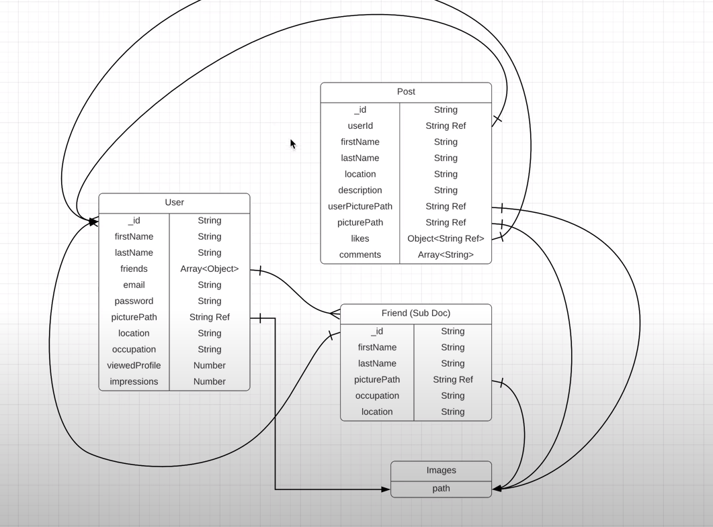
Schema Diagram

Slide 34
Server Routes
/auth/register [POST]
/auth
/auth/login [POST]

Slide 35
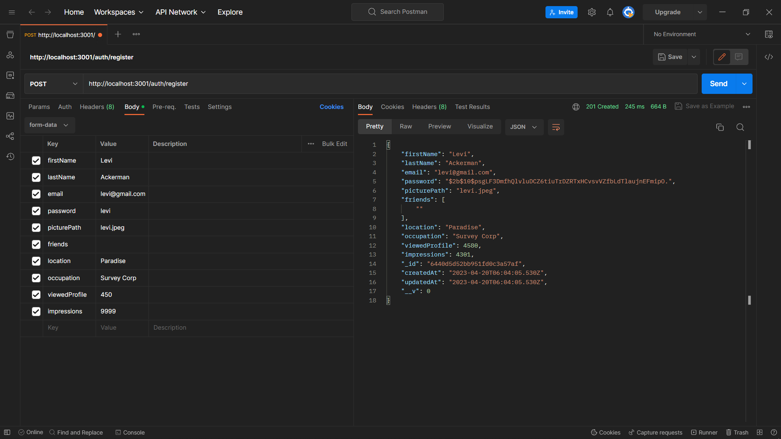

Slide 36
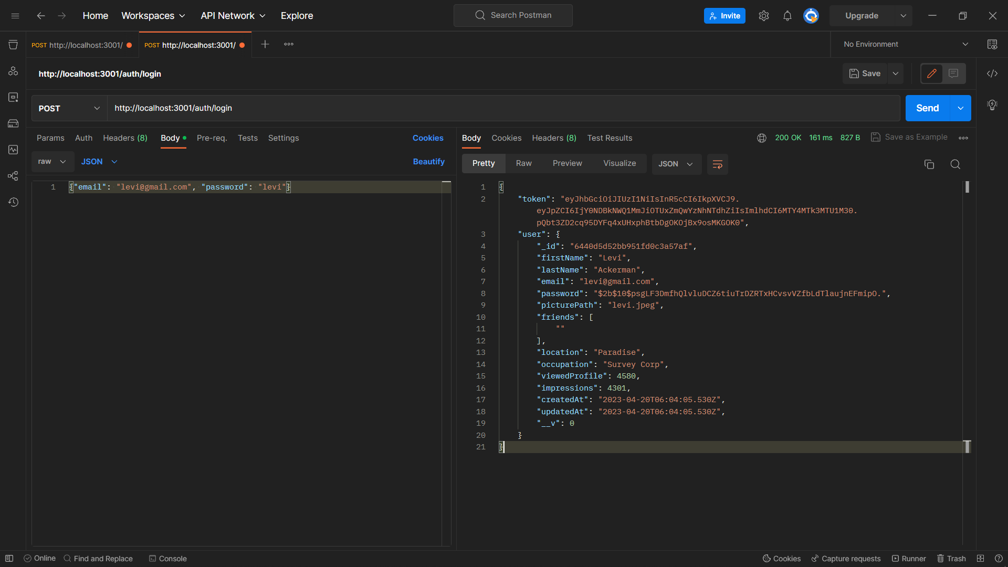

Slide 37
Server Routes
/auth/register [POST]
/auth
/auth/login [POST]
/users/:id [GET]
/users
/users/:id/friends [GET]
/users/:id/:friendId [PATCH]

Slide 38
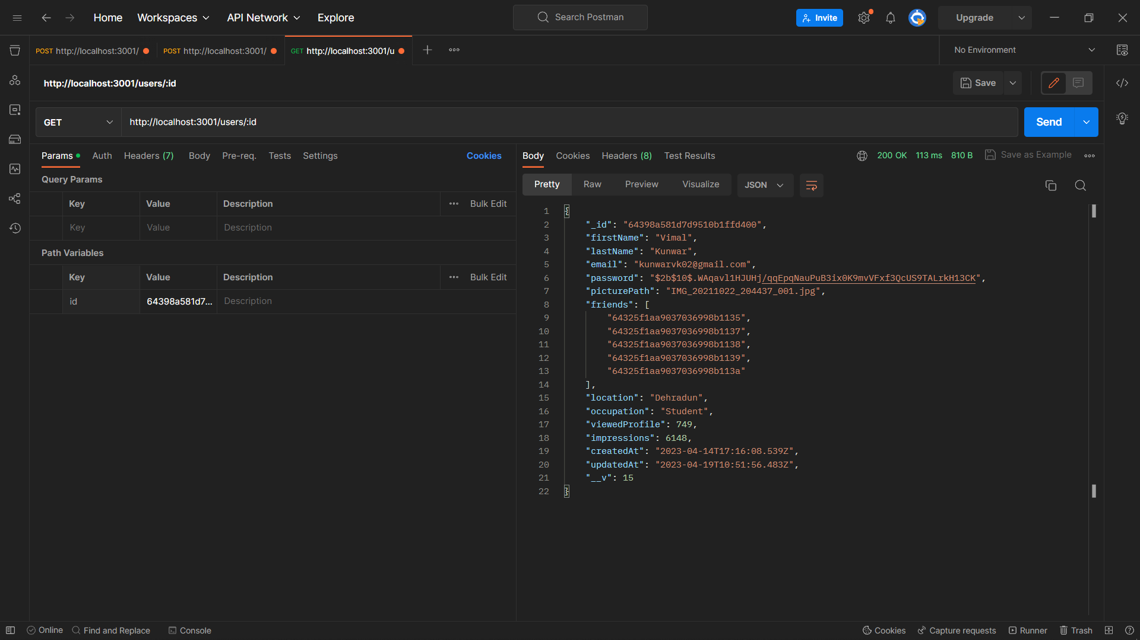
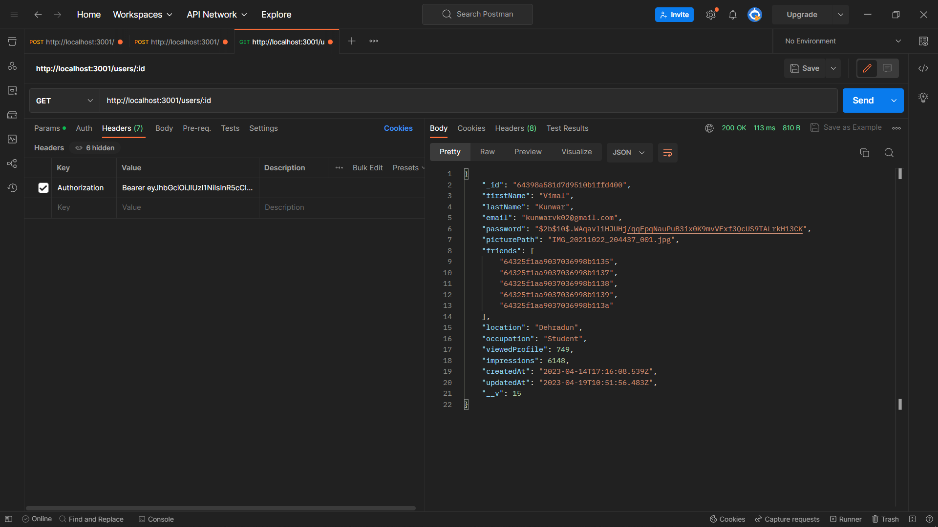

Slide 39
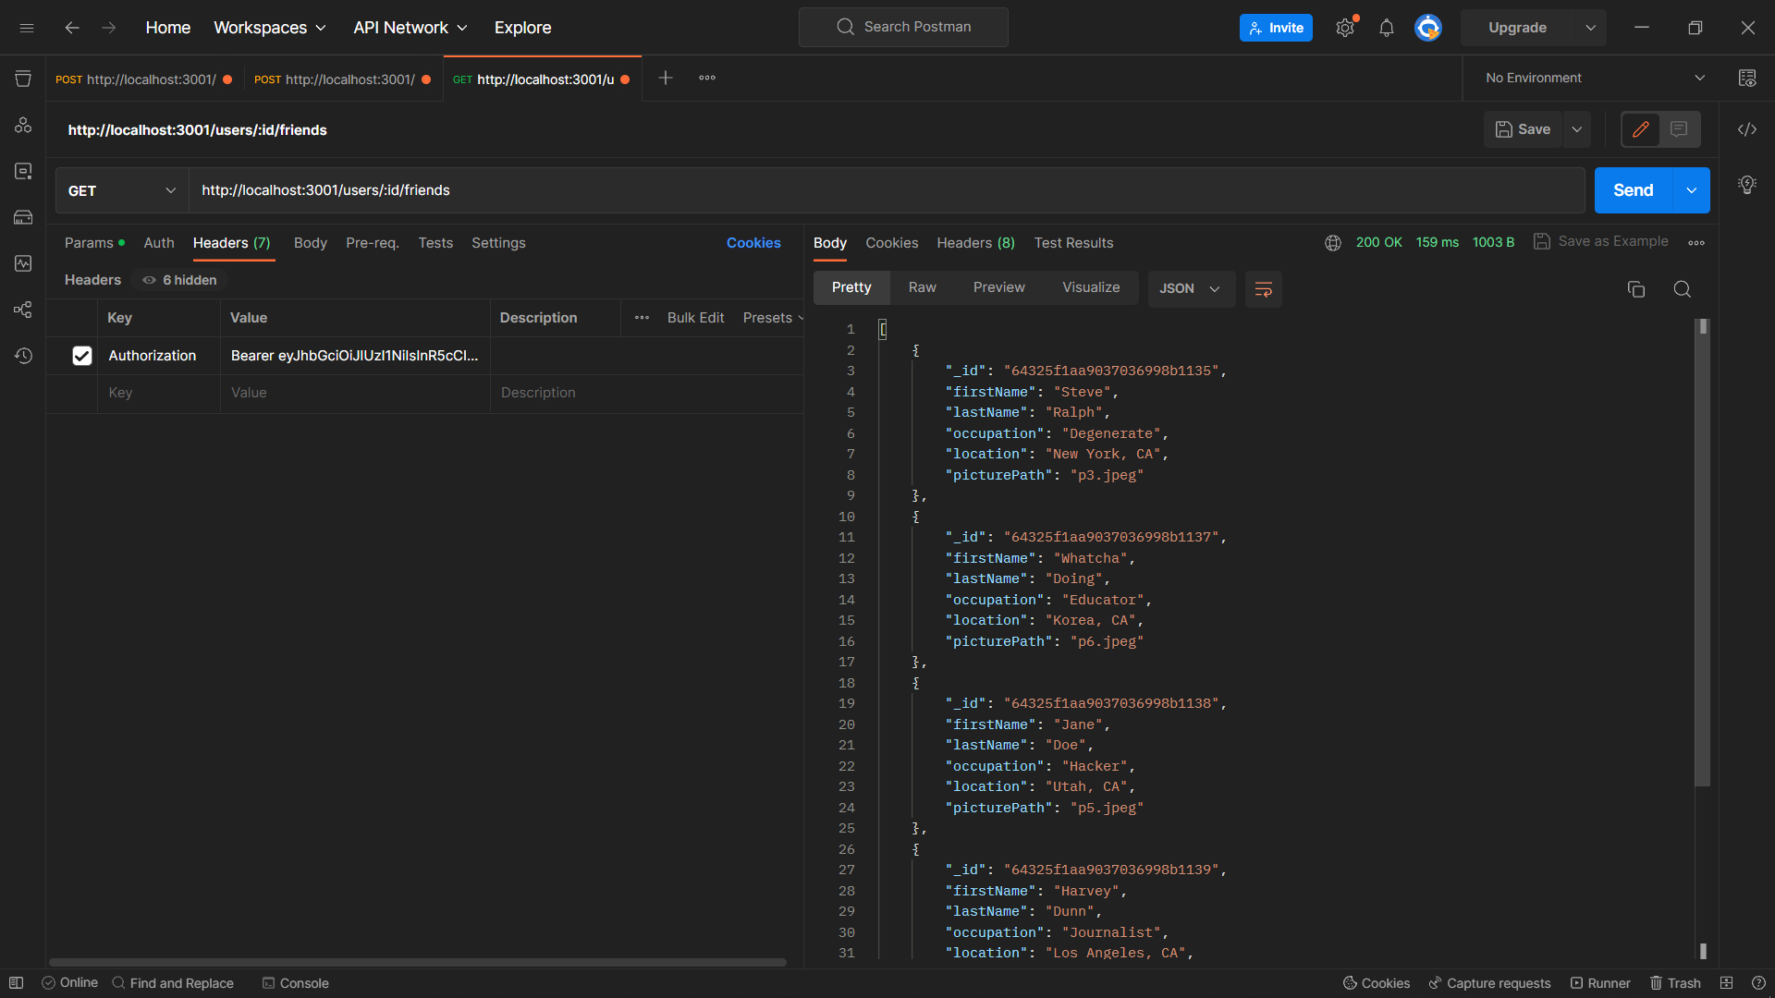

Slide 40
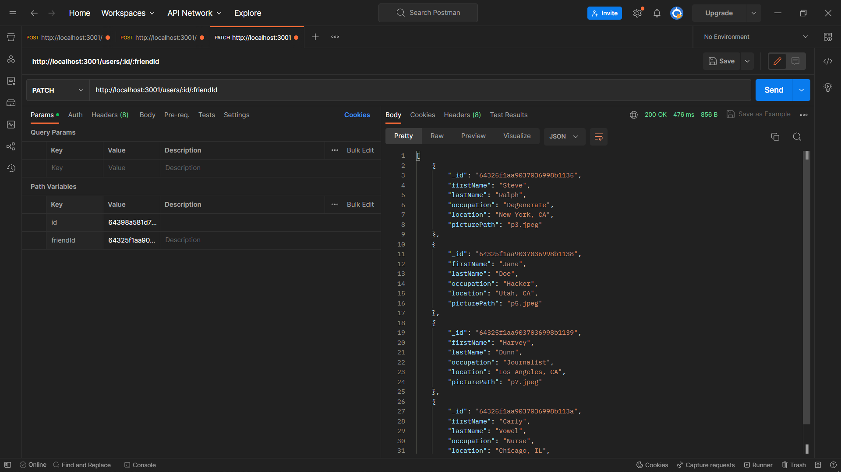

Slide 41
Server Routes
/auth/register [POST]
/auth
/auth/login [POST]
/users/:id [GET]
/users
/users/:id/friends [GET]
/users/:id/:friendId [PATCH]
/posts [GET]
/posts/:userId/posts [GET]
/posts
/users/:userId/:id [PATCH]

Slide 42
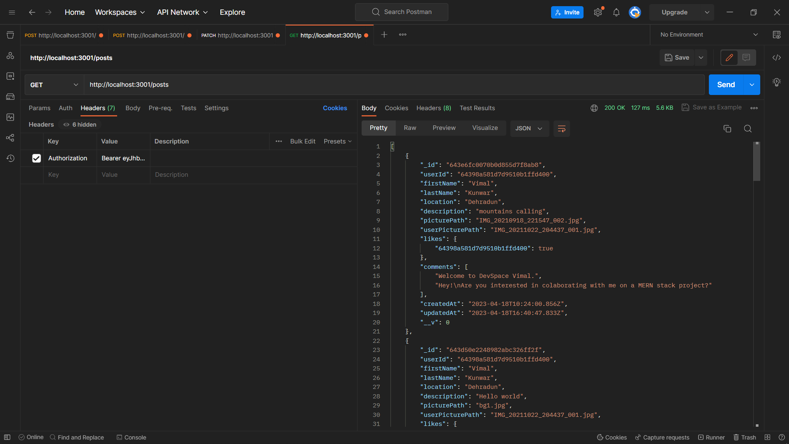

Slide 43
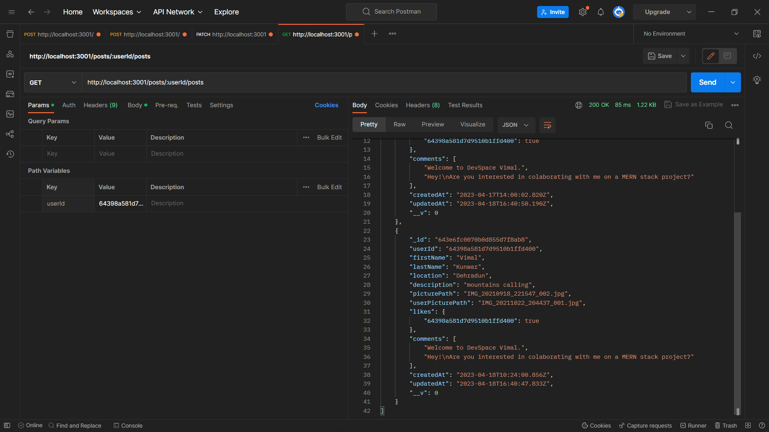

Slide 44
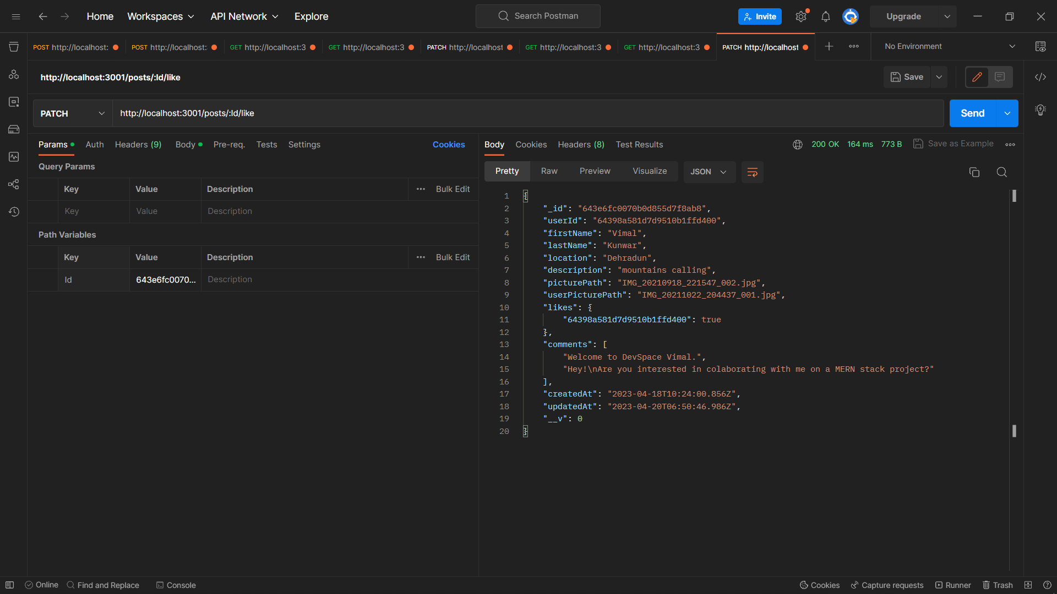

Slide 45
Server Routes
/auth/register [POST]
/auth
/auth/login [POST]
/users/:id [GET]
/users
/users/:id/friends [GET]
/users/:id/:friendId [PATCH]
/posts [GET]
/posts/:userId/posts [GET]
/posts
/users/:userId/:id [PATCH]

Slide 46
Future Changes
Few new features need to be added to the webapp, namely :
Conversation: to configure and store chats in the app.
Company/Organization Schema: to store company and employee details.
Jobs Schema: to store Jobs and their details.
Community Schema: to store details and member details.
Community Posts Schema: to store community posts and threads.
Routes: to get, post and patch community members, organization details and job applications.

